Slide 1
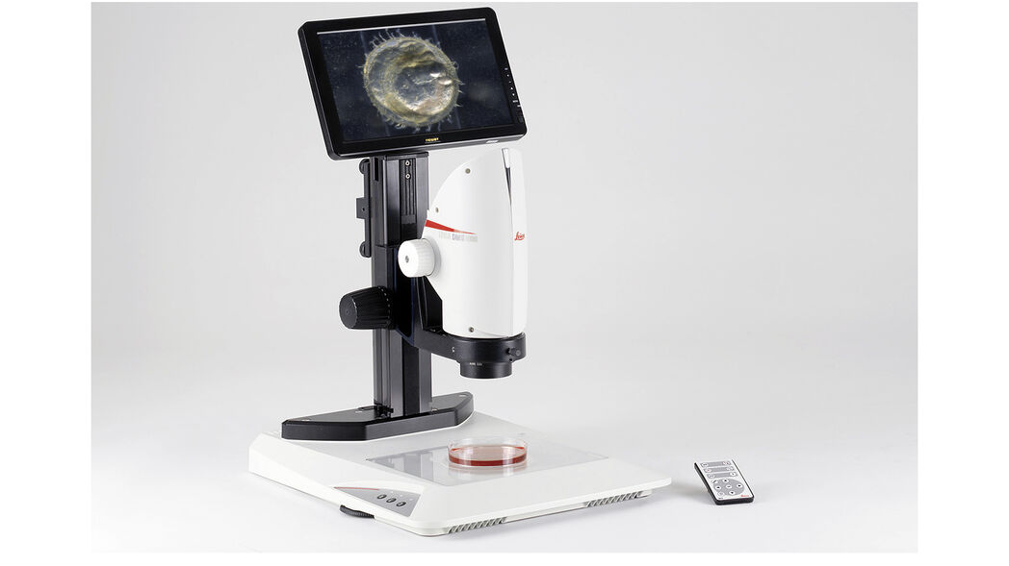
GRADUATION PROJECT DEFENSE
Smart Digital
Microscopic System
Integrating Traditional Optical Microscopy with Modern Digital Imaging and Artificial Intelligence
Supervisor
Prepared by
Dr. Awadh Ali AL-Kubati
Zahed Abdo Ghaleb Abdullah
Bashar Munawwar Hassan Saleh Wajih Al-Din
University
21 September University
Ayman Ahsan Hammoud Mane
Anwar Ibrahim Rajeh Saleh Al-Montaser
Academic Year
2026–2025
Ahmed Mohammed Abdo Othman

Slide 2
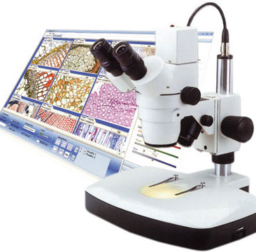
Introduction
Overview
The Smart Digital Microscopic System is designed to integrate traditional optical microscopy with modern digital imaging and artificial intelligence technologies.
The system enables automated image acquisition , enhancement , measurement , and intelligent analysis of microscopic samples.
It aims to improve accuracy, efficiency, and reliability in laboratory and medical environments.
Key Innovation
Bridging the gap between traditional microscopy and AI-driven automation

Slide 3
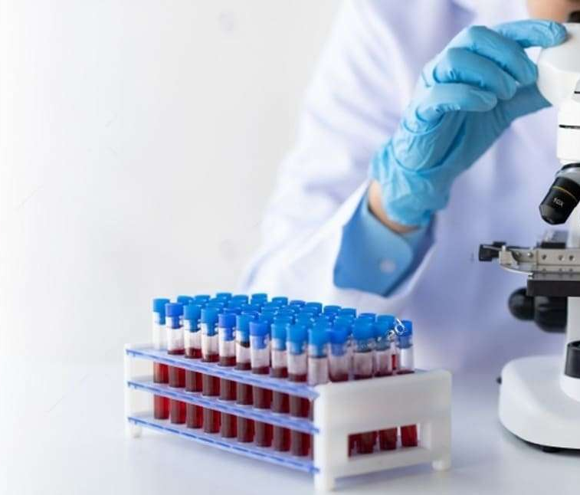
Introduction
Problem Statement
Traditional microscopes rely heavily on manual observation, which leads to:
Human Error
Inconsistent Results
Subjective interpretation varies between observers, leading to inconsistent diagnostic outcomes and potential misclassification of critical samples.
Measurement accuracy depends on operator skill and experience, resulting in variable precision across different users and sessions.
Time-Consuming
Data Management
Manual analysis requires significant time investment, limiting throughput and creating bottlenecks in high-demand laboratory environments.
Difficulty in storing, retrieving, and comparing historical data hinders longitudinal studies and quality control processes.
The Need
Therefore, there is a need for a smart automated system capable of improving precision and reducing dependency on manual examination.

Slide 4
Introduction
Project Objectives
Main Objective
To design and implement a smart digital microscope system capable of automated microscopic analysis.
Sub-Objectives
Image Capture
Image Processing
Measurement
Capture high-resolution microscopic images with optimal clarity and detail preservation.
Apply digital image processing techniques for enhancement and noise reduction.
Implement accurate measurement algorithms for quantitative analysis.
AI Integration
User Interface
Integrate an AI-based analysis module for intelligent sample classification.
Provide a user-friendly graphical interface for seamless interaction and result visualization.

Slide 5
Introduction
Project Scope
The Project Includes
The Project Does Not Include
Integration of hardware and software components for seamless operation
Industrial-scale medical device production and manufacturing
Certified clinical diagnosis and medical certification processes
Image acquisition and processing capabilities with advanced algorithms
AI-based analysis of microscopic samples for automated detection
Laboratory-based performance testing and validation
Scope Definition
This project focuses on developing a functional prototype and proof-of-concept system for academic research purposes.

Slide 6
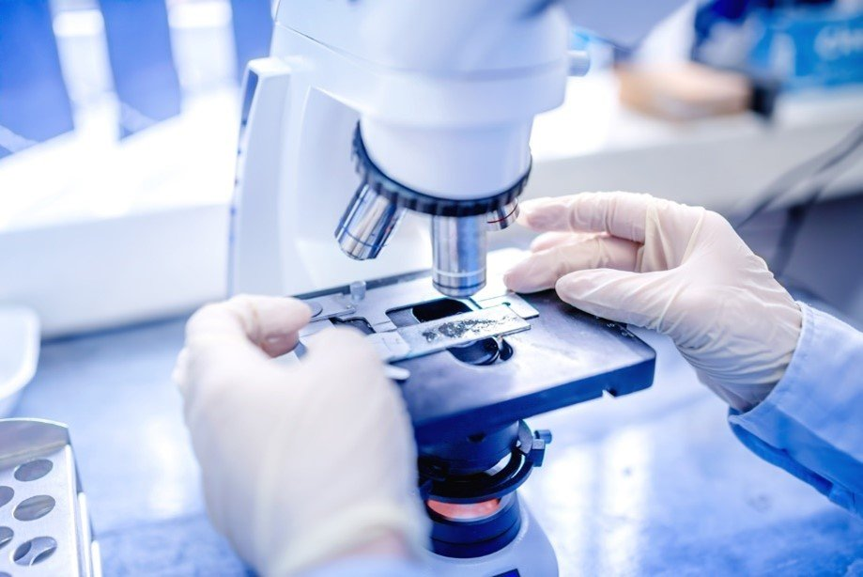
Introduction
Project Limitations
Hardware Dependency
Processing Speed
Performance depends on camera resolution and lighting quality, which may affect image clarity and analysis accuracy.
Processing speed depends on hardware capability, with complex AI algorithms requiring significant computational resources.
Dataset Limitations
Testing Environment
Limited dataset used for AI training may affect model generalization and performance on diverse sample types.
Testing conducted in controlled laboratory conditions may not fully represent real-world clinical scenarios.
Acknowledgment
These limitations are recognized and documented for future improvements and research directions.

Slide 7
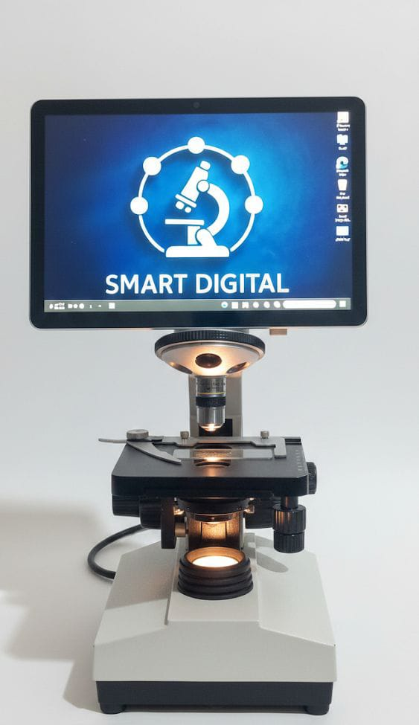
Introduction
Project Methodology
The project was developed following these stages:
1
Problem Analysis & Theoretical Study
Literature review and requirements gathering
2
System Design & Component Selection
Architecture planning and hardware selection
3
Hardware Assembly & Calibration
Physical setup and initial testing
4
Software Development & Algorithm Implementation
Coding and module development
5
AI Model Integration
Training and integration of intelligent analysis
Iterative Approach
6
Each stage involved continuous feedback and refinement to ensure system reliability and performance.
Testing, Validation & Evaluation
Performance assessment and refinement

Slide 8
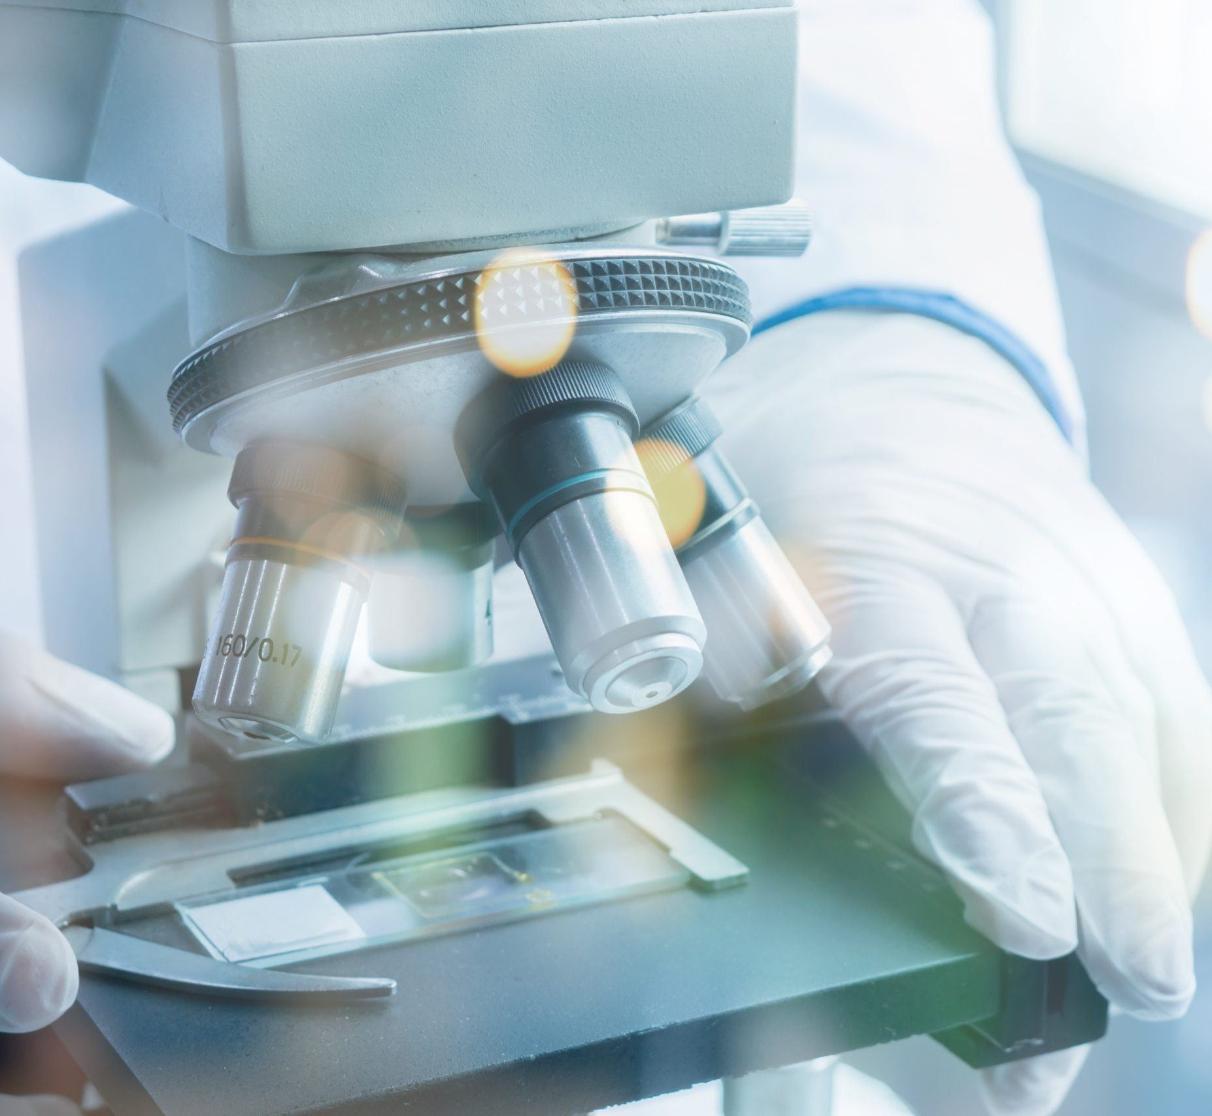
Background
Medical Background
Microscopic analysis plays a critical role in medical diagnostics, including:
Blood Cell Examination
Tissue Analysis
Complete blood count analysis, cell morphology assessment, and identification of abnormal cell types for disease diagnosis.
Histopathological examination of tissue samples to detect cancer, inflammation, and other pathological conditions.
Bacteria & Parasite Detection
Pathological Sample Evaluation
Identification of infectious agents in clinical samples for accurate diagnosis and treatment planning.
Comprehensive analysis of diseased tissue and cellular abnormalities for clinical decision-making.
Critical Importance
High precision is essential, as diagnostic errors may significantly affect medical decisions and patient outcomes.

Slide 9
Background
Literature Review
Recent studies focus on:
Digital Image Enhancement
Deep Learning Classification
Low-Cost Development
Advanced techniques for improving microscopy image quality and clarity
AI-driven approaches for automated cell and tissue classification
Efforts to make digital microscopy accessible and affordable
Research Gap Identified
Project Contribution
However, many existing systems are either expensive or lack full integration between hardware and AI components.
This project aims to provide a cost-effective and integrated smart solution that bridges this gap.

Slide 10
System Requirements
Hardware Components
Optical Microscope
Digital Camera
High-quality optical system for initial sample magnification and visualization
High-resolution imaging sensor for capturing detailed microscopic images
Mounting Structure
Illumination System
Stable mounting system to ensure image stability and precise positioning
Controlled lighting setup for optimal sample visibility and contrast
Processing Unit
Integration Focus
All hardware components are carefully selected to work together seamlessly for optimal system performance.
Computer or embedded system for running image processing algorithms and AI models

Slide 11
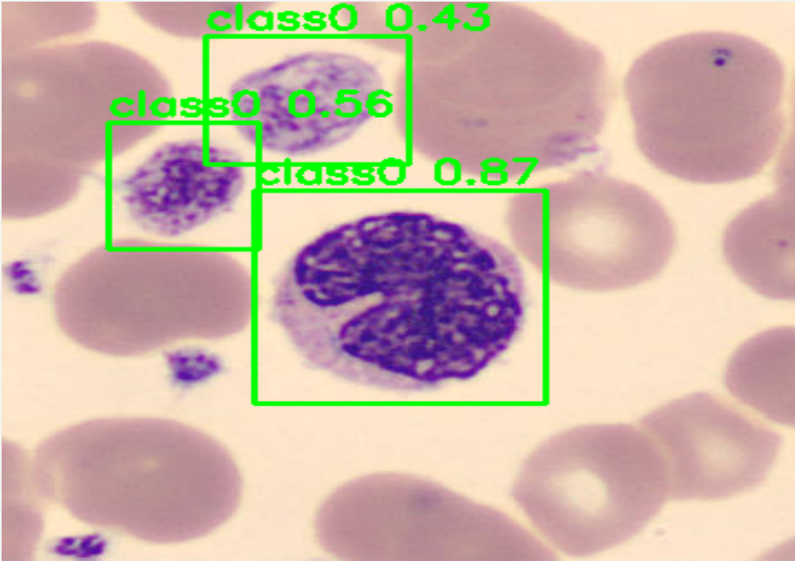
System Requirements
Software Components
Python Environment
OpenCV Library
Primary programming language for system development with extensive libraries and community support
Industry-standard library for image processing, computer vision, and real-time image manipulation
TensorFlow/PyTorch
GUI Framework
Deep learning frameworks for building, training, and deploying AI models for analysis
User-friendly graphical interface framework for intuitive system interaction
Data Management System
Technology Stack
Storage and retrieval system for organizing images, analysis results, and metadata
Modern, proven technologies selected for reliability, performance, and maintainability.

Slide 12
System Design & Implementation
Hardware Implementation
Camera Mounting
Hardware Architecture
The camera was securely mounted to ensure image stability and prevent vibration-induced blur during capture.
Optical Microscope
Lighting Optimization
Lighting conditions were optimized to reduce shadows and noise, ensuring consistent illumination across samples.
Digital Camera
Mechanical Calibration
Mechanical adjustments were calibrated to achieve accurate scaling and measurement precision.
Illumination System
Processing Unit
System Architecture Diagram

Slide 13
System Design & Implementation
Software Architecture
The software system consists of modular components:
Image Acquisition Module
Software Workflow
Handles camera interface and real-time image capture from the microscope
Image Acquisition
Preprocessing Module
Preprocessing
Noise reduction, contrast enhancement, and image normalization techniques
Feature Extraction
Feature Extraction Module
Identifies and extracts relevant features for analysis and classification
AI Analysis
Measurement & Analysis Module
Results Display
Quantitative measurements and AI-based sample analysis
Results Visualization Interface
Modular Design
The architecture follows a modular design for scalability and maintainability.
User-friendly display of processed images and analysis results

Slide 14
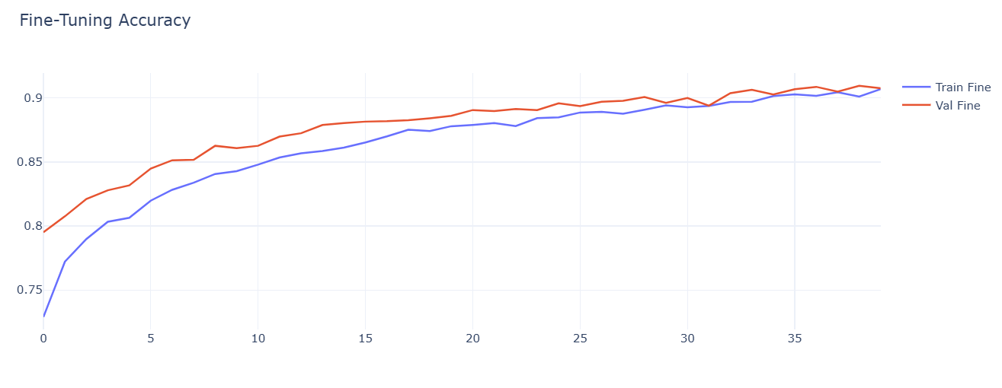
System Design & Implementation
AI Framework
Data Preprocessing
Image normalization, augmentation, and dataset preparation for model training
Model Training & Validation
Deep learning model development with cross-validation and hyperparameter tuning
Object Detection / Classification
Automated identification and categorization of microscopic structures and cells
AI Enhancement
Performance Evaluation
The AI module enhances detection accuracy and reduces manual intervention, enabling faster and more reliable analysis.
Accuracy assessment, confusion matrix analysis, and model optimization

Slide 15
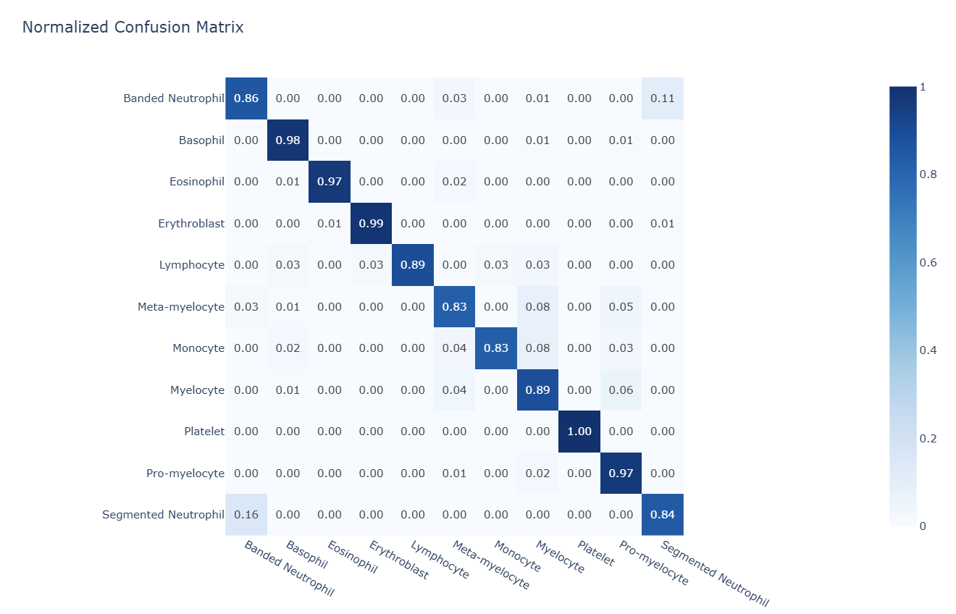
Results & Discussion
Experimental Results
Experimental results showed significant improvements across key performance metrics:
Improved Accuracy
Reduced Human Error
Enhanced measurement precision through automated calibration and digital analysis algorithms
Minimized subjective interpretation through standardized automated analysis procedures
Faster Processing
Stable & Repeatable
Performance Validation
Significantly reduced analysis time compared to manual examination methods
Consistent outputs across multiple testing sessions and different operators
The system demonstrated strong performance within the tested laboratory environment.

Slide 16
Conclusion
Project Conclusion
Successful Integration
The Smart Digital Microscopic System successfully integrates digital imaging, image processing, and artificial intelligence into a unified platform.
The system enhances:
Accuracy
Efficiency
Automation
Data Management
Precise measurements and consistent analysis results
Faster processing and reduced analysis time
Reduced manual intervention and human error
Digital storage and easy retrieval of analysis results
It represents a practical step toward intelligent laboratory automation, demonstrating the potential of AI-enhanced microscopy in modern research and diagnostic settings.

Slide 17
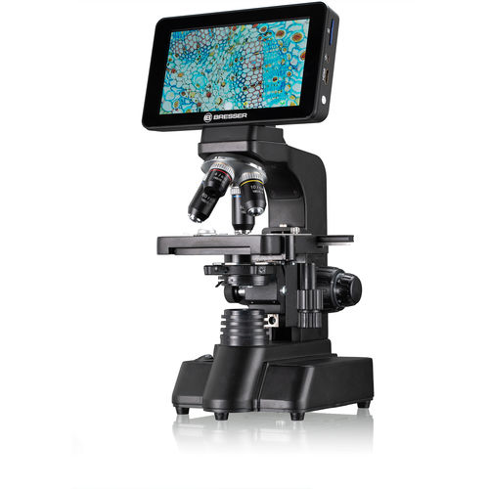
Future Directions
Future Work
Future improvements may include:
Expand AI Dataset
Advanced Deep Learning
Increase training data diversity to improve model generalization and accuracy across different sample types
Implement state-of-the-art neural network architectures for enhanced detection and classification capabilities
Automated Scanning
Cloud Integration
Add motorized stage control for automated sample scanning and whole-slide imaging
Enable remote access, data sharing, and collaborative analysis through cloud connectivity
Continuous Improvement
Higher Resolution Sensors
These enhancements will further advance the system's capabilities and practical applications.
Upgrade to higher resolution imaging sensors for capturing finer details and sub-cellular structures

Slide 18
Thank You
Thank you for your attention.
We welcome your questions.
Team
Supervisor
Year
Zahed, Bashar, Ayman , Ahmed ,Anwar
Dr. Awadh AL-Kubati
2026–2025

